Slide 1
van Kemenade
Audit Coaching Training
DYNAMIC PROJECT MANAGEMENT
Client Centered Care
Everard van Kemenade
Ph.D.

Slide 2
Who is here???

Slide 3
Content
What are we talking about?
Claims, Concerns and Issues
Why projects fail?
Start with Why?
From why to how to what
  @ phasing
  @ decision making
  @ controlling
Change battle fatigue
Hogeschool Utrecht, 25 januari 2019

Slide 4
1. What are we talking about?
Routine/process
Desk to desk
Procedures
Certain
Clear
Known
Improvisation
Ad hoc
Uncertain
Vague
New
Projects
Unique
Temporary
In phases
Control

Slide 5
The fifth Quadrant
Simple
TQM: epistemic fluency
Reflectie:
Zo wil ik het doen
IND ACTIE
Empirie:
Zo moet ik het doen: ROUTINE
Unpredictable
Predictable
Emergentie: Hoe zullen we het doen?
DYPROM
Referentie: Zo kunnen we het doen
PROJECT
Complex

Slide 6

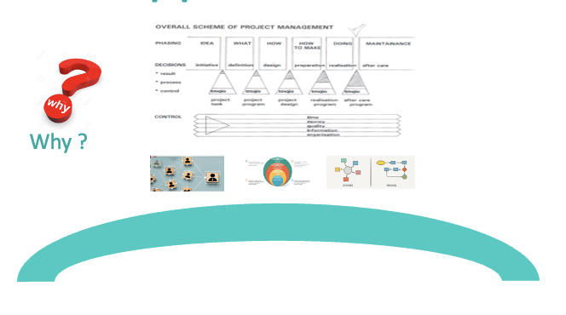
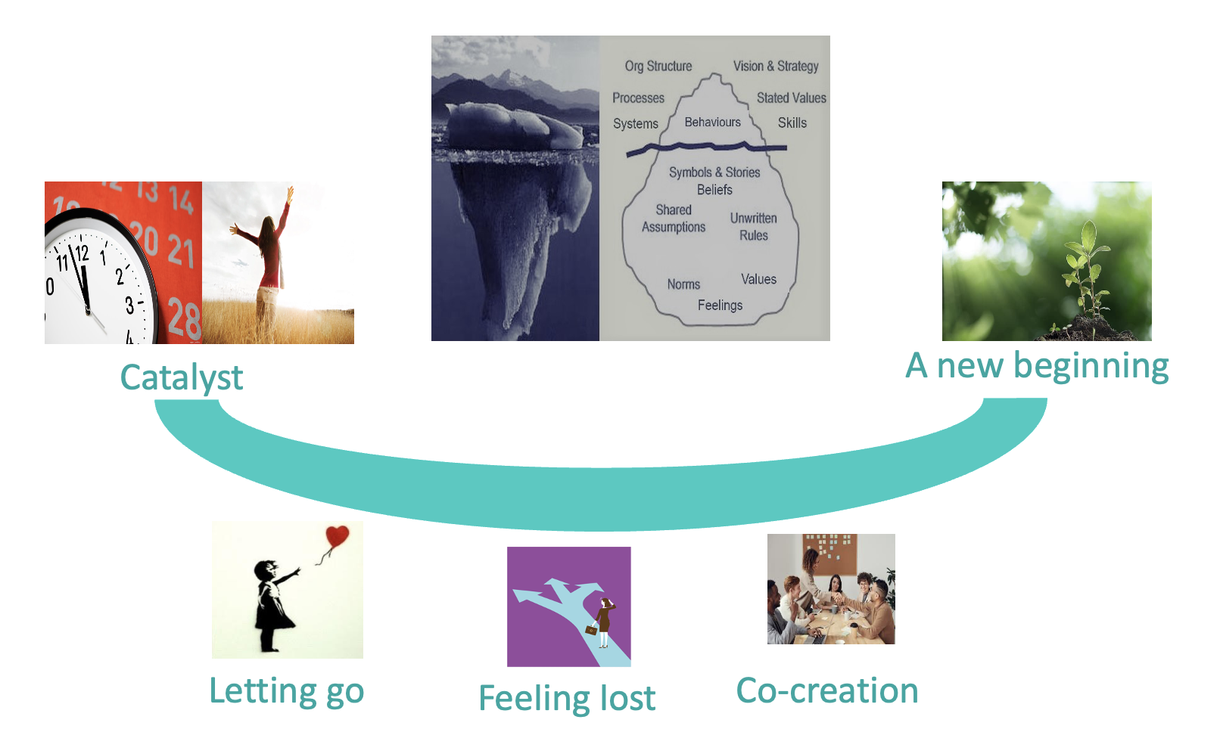
Change
Current situation
Desired situation

Slide 7
Assignment???

Slide 8
Project management
“Unique process, consisting of a set of coordinated and controlled activities with start and finish dates, undertaken to achieve an objective conforming to specific requirements, including the constraints of time, costs and resources”.
“Guidelines to quality in projectmanagement” (ISO 10006)

Slide 9
Project definition
A project is a temporarily organisation of human resources, mostly from different disciplines, to achieve a (pre-defined) objective within a defined budget.

Slide 10
Definition
Ideals
Motives
Wishes
Result
Project road

Slide 11
Types of projects
Technical nature, aiming at a change in technique or new product:
  A building like the pyramid of Gizeh or a house
  The installation of an electronic patient records
Social nature, aiming at a change in culture or organisation
  Reorganisation of a company
  Innovation in healthcare like CCC?

Slide 12
Example: CCC
Is CCC a project?
If so: what kind of a project?
What are the claims concerns and issues regarding CCC?

Slide 13
2. Claims, concerns and issues
Guba, E. & Lincoln, Y. (1989), Fourth Generation Evaluation, Beverly Hills.

Slide 14
3. Why projects fail?
Rogers,B. (2016) Why 84% of companies fail at digital transformation, Forbes, 26, 279
Marr, B. (2016) Are these the 7 real reasons why tech projects fail?, Forbes, 19,426
25% fails outright
20-25% do not show any return on investment
50% need massive reworking by the time they’re finished

Slide 15
Why projects fail? Apply to CCC.
Solving the wrong problem
Poorly defined outcome
Lack of leadership
Lack of accountability
Insufficient communication
No plan or timeline
Lack of user testing

Slide 16
Change projects
Gleeson, B. (2017), 1 Reason why most change management efforts fail, Forbes, 6,753
8. Change battle fatigue
(vgl Ajzen, 1991, Theory of Planned Behavior)

Slide 17
4. Start with why
Simon Sinek cfr Kotter (2012) Leading Change: sense of urgency

Slide 18
The right problem
Why is this a problem?
Why do we want this solved/made/done?
What exactly is the problem?
Who is the owner of the problem?
How, when and where did the problem occur?
4Wh

Slide 19
5. From why to how to what
5.1. PHASING
5.2. DECISION MAKING
5.3. CONTROLLING

Slide 20
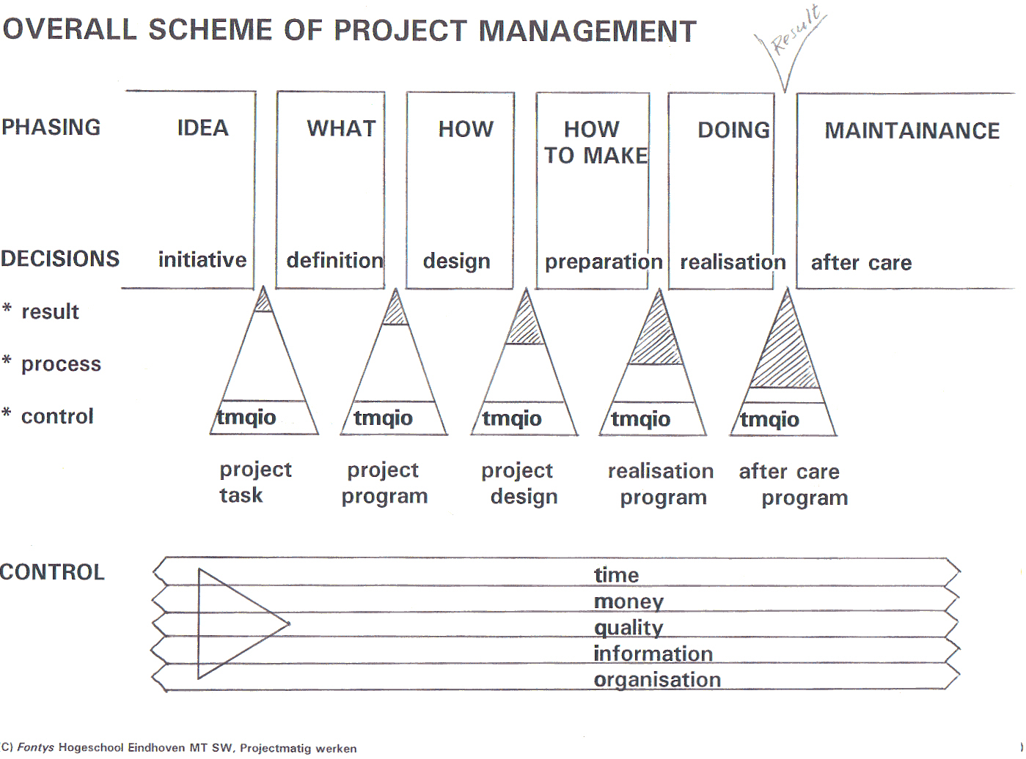

Slide 21
5.1. PHASING
INITIATIVE (idea)
  DEFINITION (what)
    DESIGN (how)
      PREPARATION (how to make)
        REALISATION (doing)
        AFTER CARE (stabilizing and
        improving)

Slide 22
Project phasing
Initiative
Definition
Design
Preparation
Realisation
Maintenance and after care
The idea
What should happen?
How should it happen?
How to realise it
Do it
Use and maintain the result

Slide 23
Phasing I: initiative
Desired result:
  There is a COMMON IDEA
  in ALL PEOPLES MINDS
  concerning THE PROJECT.
  Including: What is the problem?
  WHAT IS THE PROJECT?
  WHAT IS THE PROJECT NOT?

Slide 24
Your project form

Slide 25
Has this been done with CCC?

Slide 26
Phasing II: Definition
Desired result
  The concrete PROJECT RESULT
  is KNOWN in terms of
  PRODUCTS
  PERFORMANCES
  DEMANDS AND WISHES
  MEASURABLE: THE DEFINED OUTCOME!!!

Slide 27
Define Quality (1)
Determine clear (=SMART) the requirements of the outcome:
  What is its performance?
  How to use it? Ask users!!!!
WHAT IS GOOD ENOUGH?
WHAT IS JUST TOO POOR?
WHAT IS TOO MUCH OF THE GOOD?

Slide 28
SMART
Specific
Measurable
Accepted
Realistic
Time bound

Slide 29
Define Quality (2)
Define requirements of the intermediate results
WHO SETS THE STANDARDS?

Slide 30
Produce a definition doc
In groups

Slide 31
Phasing III: Design
Desired result (DES)
  There is a:
  DETAILED
  ELABORATED
  INTERVENTION/SOLUTION/ DESIGN

Slide 32
Has this been done with CCC?

Slide 33
Phasing IV: Preparation
Desired result
  The EXECUTION of the intervention
  Can PROCEED
  PERFECTLY
  ‘’JUST PUSH THE BUTTON’’

Slide 34
Has this been done with CCC?

Slide 35
Phasing V: Realisation
Desired result
  THE RESULT IS COMPLETELY REALISED

Slide 36
Has this been done with CCC?

Slide 37
Phasing VI: After care
Desired result
  The use
  and control
  of the PROJECT(RESULT)/INTERVENTION
  proceeds EXACTLY AS MEANT.
After care can be:
  Maintenance, provision of consumables/spare parts for sustainable continuation, refresher courses: costs

Slide 38
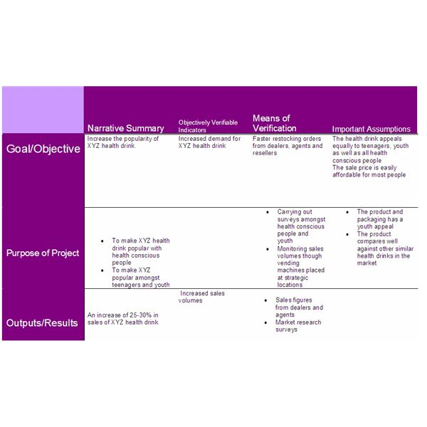
The logframe matrix
LOGFRAME

Slide 39
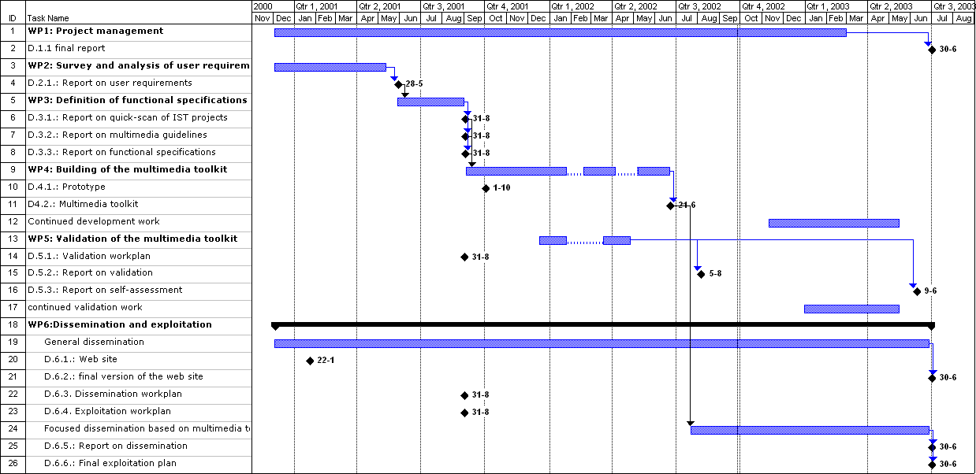
Example: Gantt chart

Slide 40
5. From why to how to what
5.1. PHASING
5.2. DECISION MAKING
5.3. CONTROLLING

Slide 41
5.2. Decision making
ASSIGN RESPONSIBILITY: LEADERSHIP
ACCOUNTABILITY BY INTER-MEDIATE RESULTS
Does the chosen way still lead to the best possible solution of the problem to solve?
Should we adjust to improve the quality of the result? Which adjustments?
GO/NO GO

Slide 42
Responsibilities
CAIROS
Consulted
Accountable (decision maker)
Informed
Responsible (execution)
Out of the loop
Supportive

Slide 43
Decision Making
Result
Process

Slide 45
Has this been done with CCC?

Slide 46
5.3. Control (1)
Money (geld)
  What are the limits of costs and required results?
  (Money once spent will not return)
Organization (organisatie)
  Everyone knows:
    who has which task
    and which competence
    how will be cooperated
    and delegated.

Slide 47
Control (3)
Quality (kwaliteit)
  Let users test continuously.
    What is good enough?
    What is just too poor?
    What is too much of the good?

Slide 48
Control (2)
Information (informatie)
  Define results clearly, approve them and publish them.
  Get authorization of changes.
  Sufficient communication!
Time
  When is it finished and how many capacity do we have?
  Set deadlines and stick to these.

Slide 49
S.O.S
If you don't know something it is important that you ask for help. When you are project manager for a $1,000,000 project you need to put your ego to one side and call on others. You are not expected to know every detail about everything, so don't be afraid to stop and ask for help. Overconfidence could severely damage your reputation and your project.

Slide 50
Control
In Dutch
Geld
Organisatie
Kwaliteit
Informatie
Tijd
GO-KIT

Slide 52
Has this been done with CCC?

Slide 53
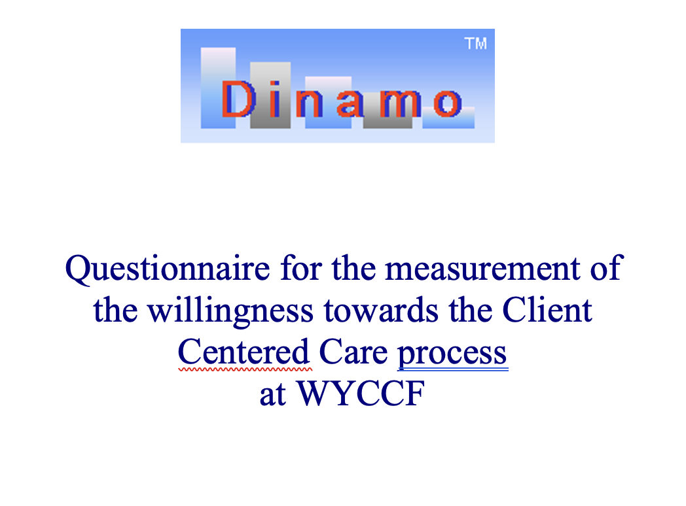
QUESTIONNAIRE

Slide 54
6. Change battle fatigue

Slide 55
6.1. From Project to Program Management
Ideals
Motives
Wishes
Result
Ideals
Motives
Wishes
Project road
Result
Ideals
Motives
Wishes
Project road
Result
Ideals
Motives
Wishes
Project road
Result
Ideals
Motives
Wishes
Project road
Result
Ideals
Motives
Wishes
Project road
Result
Ideals
Motives
Wishes
Project road
Result
Ideals
Motives
Wishes
Project road
Result
Ideals
Motives
Wishes
Project road
Result
Ideals
Motives
Wishes
Project road
Result
Ideals
Motives
Wishes
Project road
Result
Ideals
Motives
Wishes
Project road
Result
Ideals
Motives
Wishes
Project road
Result
Ideals
Motives
Wishes
Project road
Result
Ideals
Motives
Wishes
Project road
Result
Ideals
Motives
Wishes
Project road
Result
Project road

Slide 56
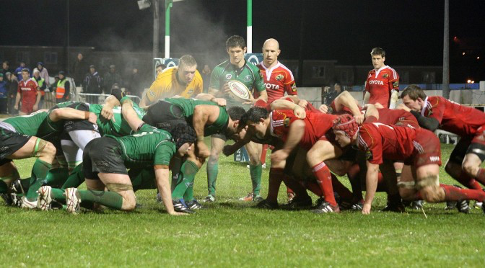
6.2. Scrum

Slide 57
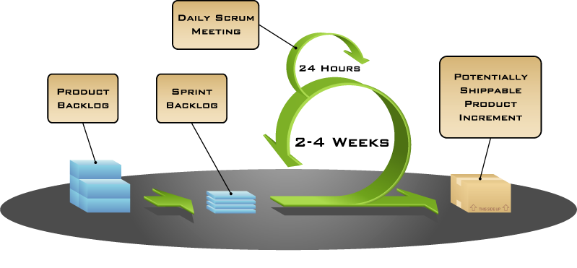
www.scrumguide.nl

Slide 58
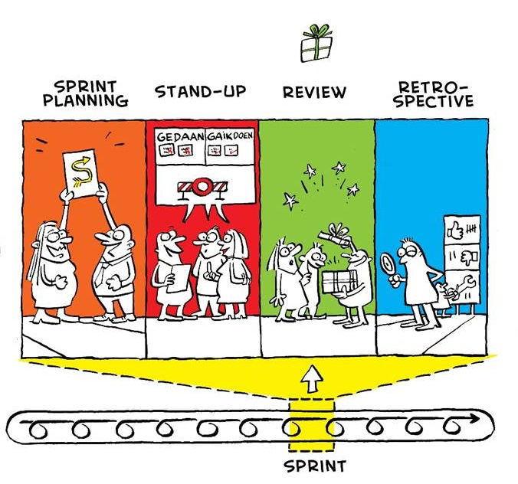

Slide 59
Scrum
Sprintplanning (slots of half a day)
Stand up (every day/week meeting 15 min)
Review (product demo with user)
Retrospective (self evaluation)

Slide 60
Dynamic
Program
Management ©
Van Kemenade and Cornelissen (1999) Dynamisch project management: het beheersen van het onbeheersbare, OnderwijsInnovatie 3, Open Universiteit
https://www.vankemenade-act.nl/wp-content/uploads/2019/01/Dynamisch_projectmanagement_artikel.pdf

Slide 61
Project management
Result focus
Time,money,organisation, quality, information
Six stages
Clear SMART goals
One boss
Walk into a trap
Program management
Focus on broader goals
Efficiency, effectivity, flexibility
Spiral
Acceptmore vague, even conflicting goals
More influencing stakeholders
Move with the flow

Slide 62
Dyprom situated
Routine
Desk to desk
Procedures
Certain
Clear
Known
Improvisation
Ad hoc
Uncertain
Vague
New
Projects
Unique
Temporary
In stages
Control
DYPROM
SCRUM

Slide 63
Conclusions to Dyprom
Quality can vary (accept change during the project)
Broad assignment within program lines
Control relations between projects in the program (Scrum: sprint)
Record changes
Commitment from everyone; motivate people by shared values
and creating a team culture by setting virtues
6. Involve the user from the beginning
Lessons learned (Scrum:stand up) and successes celibrated
(Scrum:retrospective)
8. Continuous dialogue

Slide 64
Assignment
Work in teams of 2-3 persons
What can you do to improve the CCC project, based on the presentation?
Use the format

Slide 65
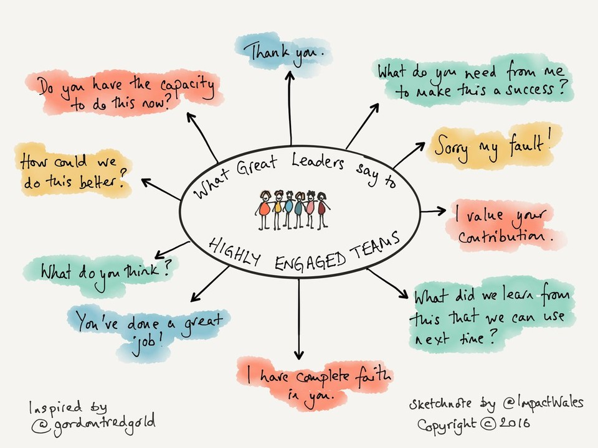
Great Leaders

Slide 66
Why projects fail? Apply to CCC.
Solving the wrong problem
Poorly defined outcome
Lack of leadership
Lack of accountability
Insufficient communication
No plan or timeline
Lack of user testing

Slide 67
Change projects
Gleeson, B. (2017), 1 Reason why most change management efforts fail, Forbes, 6,753
8. Change battle fatigue
(vgl Ajzen, 1991, Theory of Planned Behavior)

Slide 68
Literature
Wijnen, G. en Storm, P (2007), Projectmatig werken, Spectrum., Utrecht
Migchelbrink, F. (2012), Projectmatig werken en onderzoek. Een handleiding voor professionals in onderwijs, zorg, welzijn en wonen, SWP, Amsterdam
HBR (2012), Guide to Project Management, Harvard Business School Publishing, Boston
Bekkering, T. (2011) Projectmanagement. Nieuwe invalshoeken, Spectrum, Utrecht

Slide 69
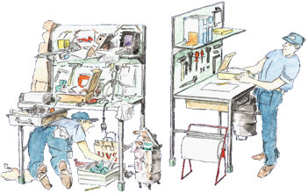
Design a One Day WYCCF 5-S project

Slide 70
What
Four groups
One day
For StMH and SBC (four buildings)?
Using the 5S model
Involve as many as possible
Doable

Slide 71
5S model

Slide 72
5S
The way to success!
Sort
Shine
Sustain
Set
Standardise
Notes:
This is a Japanese Quality Tool, called 5-S

Slide 73
5S
Sort
What do you need and what is not necessary?
Remove what is not necessary like docs,
materials and personal belongings.
Keep only what you need for the job.

Slide 74
Sort
Gather the materials not necessary.
Discuss and dispose off unnecessary stuff.

Slide 75

Sort
Set
.

Slide 76
5S
Set
Put things in a logical place, close where you need it.
Make it a fixed place and decide on the amount of it needed.

Slide 77
How many balls and which color is least?
Notes:
Show this slide about 10 seconds
Make the screen black
Ask how many balls
And Ask which ball is missing?
Show the slide again if necessary
Let participants shout numbers and colours through the room
Then show next slide

Slide 78
How many balls and which color is least?
Notes:
36!!!
Visual order, hej… one green ball is missing!
Urge participants to use visual systems in year 4
Visual = you see at once / direct what is normal and what is not normal
Without asking

Slide 79
Everything has a place and is there

Slide 80
5S
The way to success!
Sort
Shine
Set

Slide 81
5S
The way to success!
Shine
Remove garbage, dirt and waste.
Make materials, working places clean and keep them clean.
Is everything in good order and ready to use?

Slide 82
Who is responsible?
Make cleaning possible.
SAFETY!
Everybody, not just the cleaning staff!

Slide 83
5S
The way to success!
Standardise
Design standardised procedures.
Use checklists.
Make arrangements with all team members to do it like that.
Train them to do it like that.

Slide 84
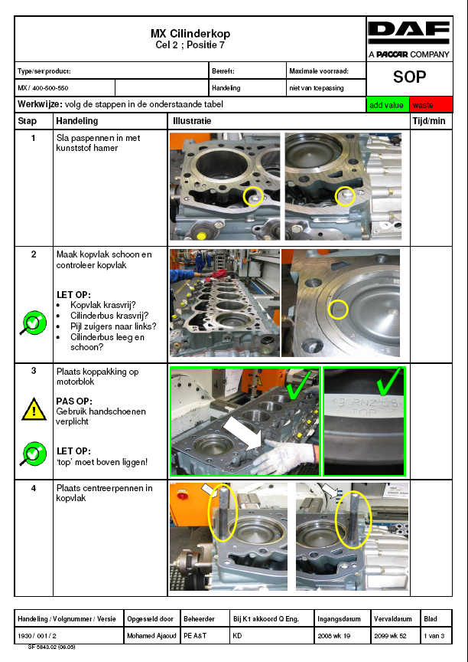
Standard Operating Procedures
Werkplekinrichting
‘5S: Een plek voor alles, en alles op zijn plek’
Notes:
The primary objective of the stability phase is to create a basis for consistency so “reality” can be seen and random activities can be removed. This forms the foundation for continuous improvement opposed to fire fighting.
Before I go into the other elements of basic stability, I want to zoom in on standardized work as one of the most important building blocks of the DAF Production System.
Engineers spend hours on making their best working way only to discover the operator found a better way. Unfortunately every operator has discovered a better way. This introduces defects, variation and thus basic instability.
Together with the operators ‘a best way of performing the operations is recorded in a so called work sheet combination table, a process layout diagram and a knowledge sheet. Together they form the basis for standardized work. At our first stop in the Engine Plant standardized work will be explained in more detail.
Of course before you can even start standardizing you need to clean up and organize your operations. Implementing 5S’s is one of the first steps a team undertakes. It boosts team spirit and the results are visible instantly as you can see in the picture below.

Slide 85
5S
The way to success!
Sustain
Be a critical friend to your peers
Party on your successes

Slide 86
5S
The way to success!
Sort
Shine
Stimulate
Set
Standardise
What unnecessary materials are in your department?
How can you sort equipment to be fixed on the right place?
How can the environment be cleaned and maintained well?
What can you standardize?
How can you stimulate the above to keep arranged?

Slide 87
Assignment
1. Walk around. Look what needs to be done
2. Design a five S day project
3. Take pictures
4. Describe
  4.1. initiative: why
  4.2. definition: what
  4.3. design: how

