Slide 1
SITUATIONAL LEADERSHIP
TRAINING
Everard van Kemenade

Slide 2
Program
Day 1
Introduction
What keeps you awake at night?
Leadership versus management
Vision and Strategy
Situational leadership

Slide 3
1.Introduction
Name
Function
Expectations
What keeps you awake at night reg. work?
(choose a photo to express)

Slide 4
CARDS

Slide 5
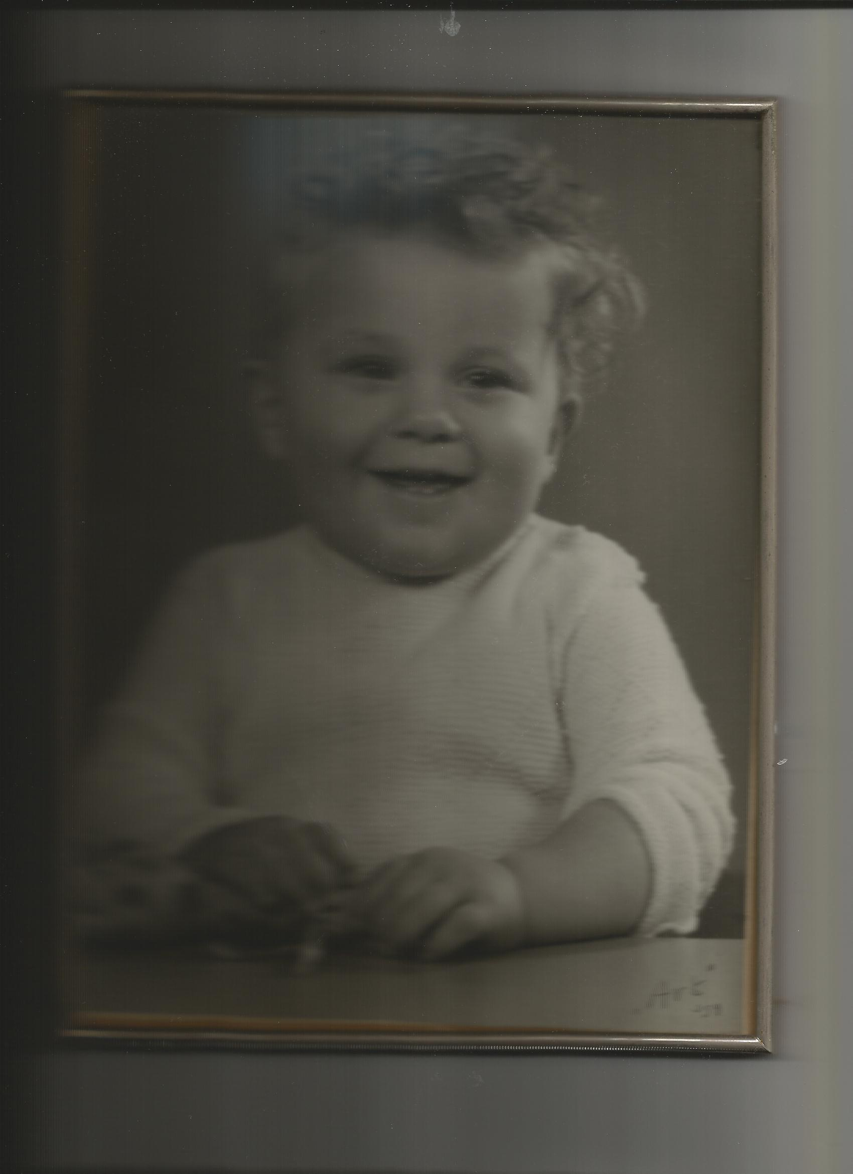
ME
1953 born

Slide 6
2. What keeps you awake at night?
2.1. 4Wh
2.2. Cause-effect analysis
2.3. Incident method

Slide 7
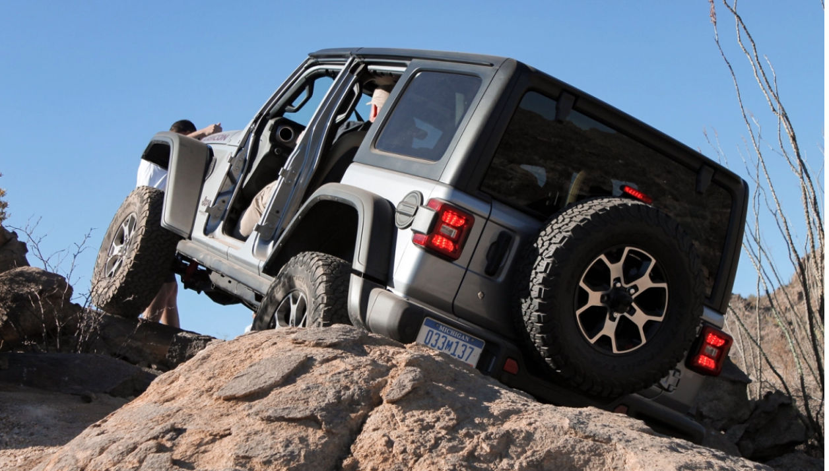
2.1.

Slide 8
  2.1. What keeps you awake at night?
  Groups of two
4Wh
What is the problem?
When or Where does it occur?
Why is it a problem (5 x Why)?
Whose problem is it?
How does it occur?
And what would you like to do about it?

Slide 9
  2.2. Cause-effect analysis
  One plenary example

Slide 10
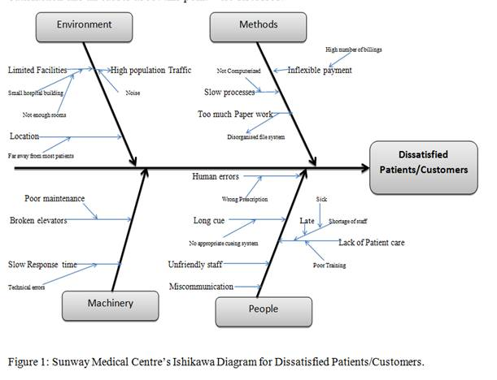

Slide 11
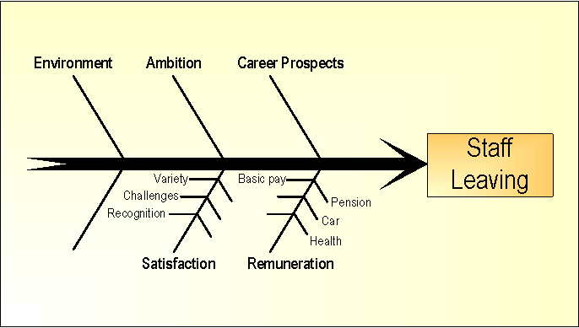

Slide 12
The 6 Ms
Machine (technology)
Material (Includes Raw Material, Consumables and Information.)
Method (process)
Man Power (physical work and mind Power)
Management
Milieu/Mother Nature (Environment)

Slide 13
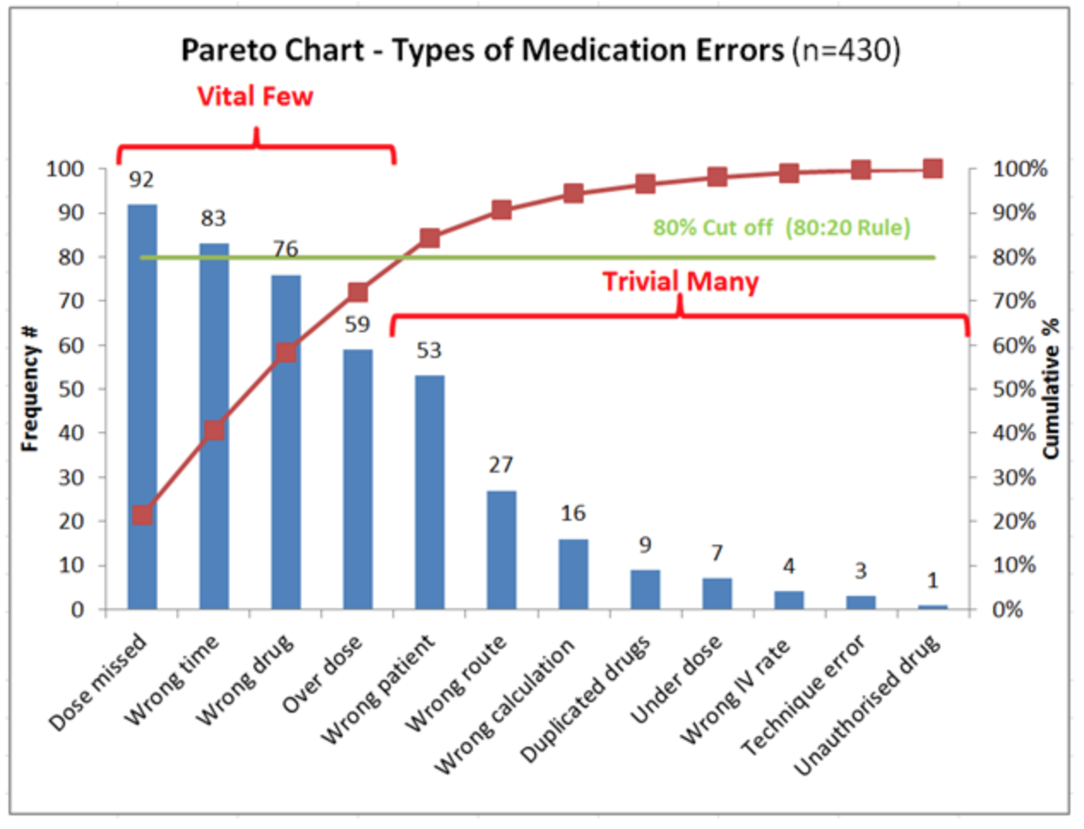
  What are the main causes?
Score all causes in the group
Pareto. (20% causes 80%)

Slide 14
2.3. INCIDENT METHOD
Intervision: 3 groups

Slide 15
7 steps
1. Start (10 min)
(Choose changing chairman, report of problem owner last meeting is discussed and actions taken are reported)
2. New actual problem brought in and chosen (10 min)
(short context of situation, the incident, just up to the critical moment)

Slide 16
3. Clarification of the problem (20 min)
Informative, factual questions, suspending judgement, asking for emotions as well.
The story is completed with actions that have been taken and results of these actions.
4. Awareness (10 min)
Participants raise open questions (what, how, what could you, how would you, if). Problem owner reacts/answers.
NO ADVISE
The end is a consultancy round with suggestions for action. If I would be in your situation, I would…..

Slide 17
5. Evaluation by problem owner
The best suggestions
The actual actions that will be taken
6. Learning outcomes and agreements (10 min)
Experience of the meeting
7. Reflection report
Problem owner writes one page report for next meeting
What insights gained, what actions taken, results, experience of meeting, what else?
Advise does not fit most of the time, even embarrassing or making you small

Slide 18
Summary
1. Start
2. Story until critical moment
3. Clarifying questions
4. Open questions !! What could you, how could you.. (end only 2’’ advise)
5. Evaluation by problem owner
6. Learning outcomes
7. Actions he/she will take (report)

Slide 19

Break

Slide 20
Program
Day 1
Introduction
What keeps you awake at night?
Leadership versus management
Vision and Strategy
Situational leadership

Slide 21

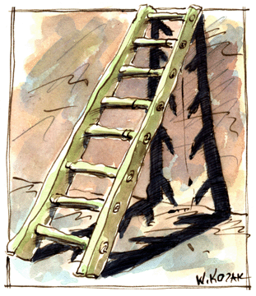
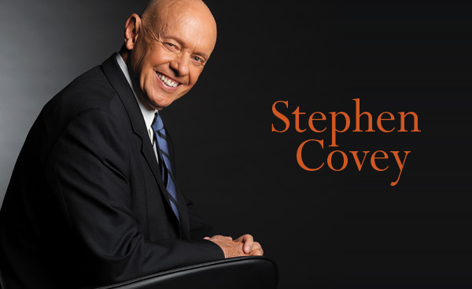
LEADERSHIP = MANAGEMENT?
Managers assure that ladder is climbed efficiently (processes).
Leaders assure that ladders are placed at the right wall (goals).

Slide 22
LEADERSHIP = MANAGEMENT?
As I see it, leadership evolves around vision, ideas, direction and has more to do with inspiring people and direction and goals than with day-to-day implementation. … One can’t lead unless he can leverage more than his own capabilities … You have to be capable of to do things without actually sitting on top of people with a checklist – which is management, not leadership.
“John Sculley, former CEO of PepsiCo and Apple
Notes:
Uitreiken Shriberg pag 134 t/m 135

Slide 23
A first class manager hires first class people and leaves them alone.
A second class manager hires third class people,
tells them what to do and –even worse-
how to do it.

Slide 24
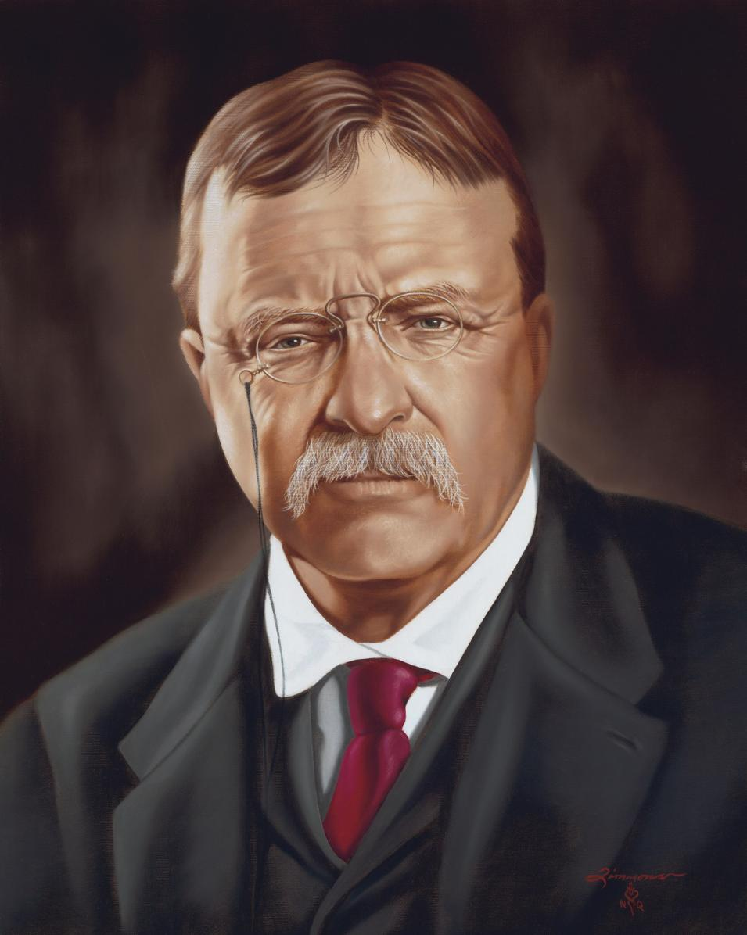
"People ask the difference between a leader and a boss.
The leader works in the open and the boss in covert.
The leader leads and the boss drives."
Theodore Roosevelt

Slide 25
“Organisations nowadays are over-managed and under-lead”.

Slide 26
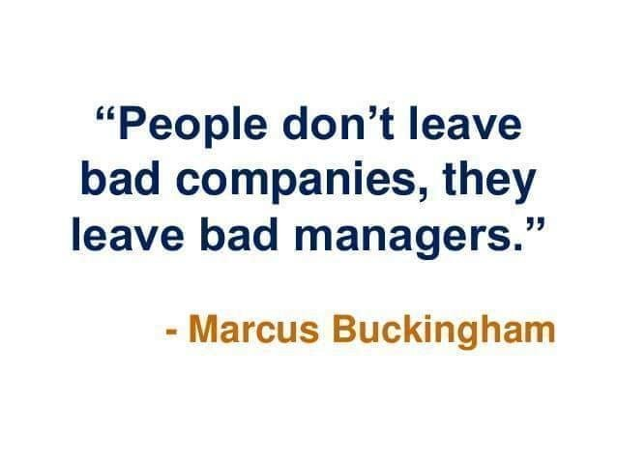

Slide 27
Examples

Slide 28
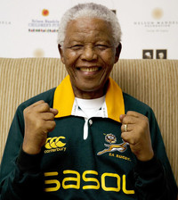
“A leader. . .is like a shepherd. He
stays behind the flock, letting the most nimble go out ahead, whereupon the others follow, not realizing that all along they are being directed from behind.”

Slide 29
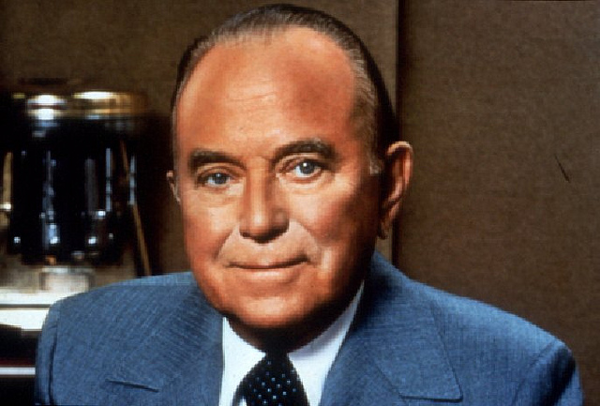
"The quality of a leader is reflected in the standards they set for themselves.”
Ray Kroc
CEO McDonalds

Slide 30
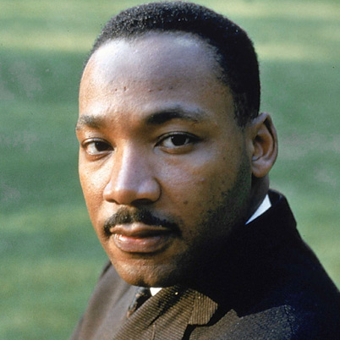
A genuine leader
is not a searcher
for consensus but
a molder of
consensus.

Slide 31
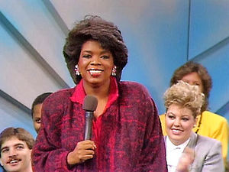
“Think like a queen. A queen is not afraid to fail. Failure is another steppingstone to greatness.”

Slide 32
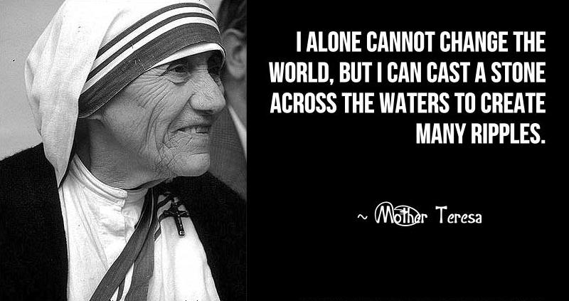

Slide 33
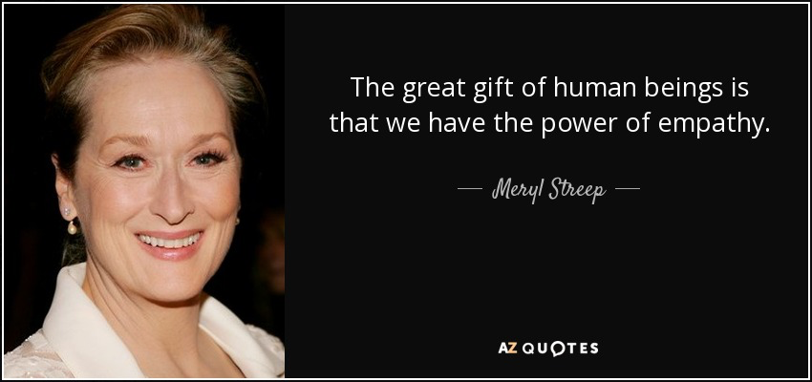

Slide 34
What makes a good leader?
GOOD LEADER

Slide 35
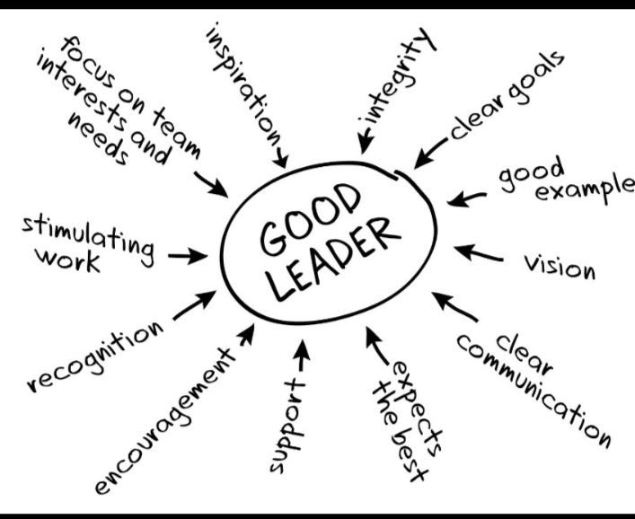

Slide 36
5 characteristics
question | Yes | Somewhat | No
Have you defined vision and strategy?
Have you worked with each employee on their role?
Meet regularly with employees individually?
Empower employees?
Recognize great work?

Slide 37
van Kemenade
Audit Coaching Training
4. Visionairy leadership
Liberating the corporate soul

Slide 38

DANCING GUY

Slide 39
Leadership
Leadership is the ability of an individual or a group of individuals to influence and guide followers or other members of an organization.

Slide 40
Why should someone follow you?
(Group of two, opposite to each other)

Slide 41
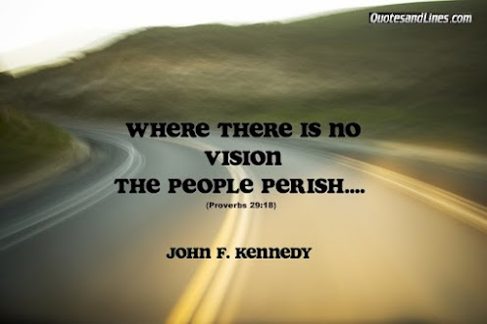
Vision

Slide 42
Vision
On care
  https://fb.watch/fNhKQDLN29
On future
  Example SBC

Slide 43
THE VILLAGE
A Vision of Sister Basilia Centre (SBC) for 2020-2025
The SBC’s vision is a world where communities, families, and caregivers join together to create nurturing environments in which all clients are embraced as unique, valued individuals.
We strive to develop the clients towards self-management as much as possible. We want our clients to be happy. We strive to integrate our clients and have them valued in the community. We want SBC to become the nr 1 centre in the Caribbean.

Slide 44
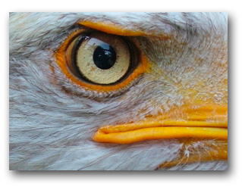
VISION!!!
Jicho la mkubwa ni jicho la tai. (Swahili)
The leader's eye is like an eagle's eye

Slide 45
Vision
From Latin: vidēre, to see, to look out for
What do we want to be/become?
The companies vision declares the intention with regards the future it desires to create.
What the company is striving to achieve.
The vision should create a long-term motivational alignment between employees and the organization and generate social goodwill.
The vision describes “the end”, the “desired state”.
What IMPACT will you have on the lives of others.........

Slide 46
Vision
Three elements (CIA):
Charisma: the direction we want to go for
for the clients, the vision should
appeal to all stakeholders
Inspiration: clear focus for the employees, it
should inspire and touch staff and
make them move and ready for change
Ambition: it should reflect the dreams, passion
and desires of people, long term
objective to strive for.

Slide 47
WYCCF Vision
Vision:
“The White and Yellow Cross Care Foundation strives to deliver sustainable trusted CARE. We
want to identify and fulfil prevention, cure and care needs on Sint Maarten, for our residents and
those of surrounding islands. This evolving and diverse environment offers career and personal
development opportunities to our committed employees.”
CIA? Direction for clients? Inspiration for staff? Ambitious?

Slide 48
Saba Cares
Vision:
Saba Cares strives to deliver care that is trusted and sustainable. This diverse environment offers professional development for our employees. We are committed because we care.
CIA? Direction for clients? Inspiration for staff? Ambitious?

Slide 49
MHF
Vision Statement:
Our vision is ‘the promotion of continuity and consistency, prevention, psychiatric treatment, cure and wellness to all of our clients. We provide for their actual needs with focus on their environment, wishes, job support and financial stability.’
CIA? Direction for clients? Inspiration for staff? Ambitious?

Slide 50
Embed your vision
A vision becomes an instrument of change when it is understood and accepted by all stakeholders.

Slide 51
Conclusion
Having a vision is important for you as a leader.
Crucial is that the organisation has a shared vision,
that starts from within.

Slide 52

Vision and action

Slide 53
Vision and Action
Emergent
  Brainstorm like; no agenda; interaction of different experts
  Novelty, innovation; facilitator
Planned
  Structure, PDCA, clear decision making: director / coach

Slide 54


Slide 55
Vision-Strategy-Action

Slide 56
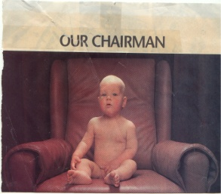
EFQM
D
C
P
1 Leadership
3 People
management
5
Processes
7 People satisfaction
€
9 Key Performance
2 Policy and strategy
6 Customer satisfaction
4 Resources and partners
8 Impact on society
Enablers
Results
A
28-10-2022

Slide 57
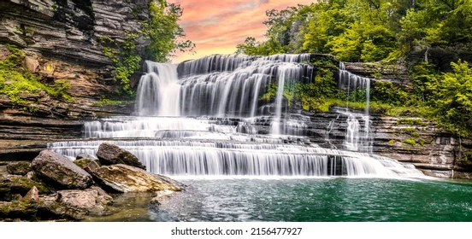
Cascade

Slide 58
ACTION PLANS at all levels
Nr | what | who | when | needs | Evidence of success
1.
2..

Slide 60
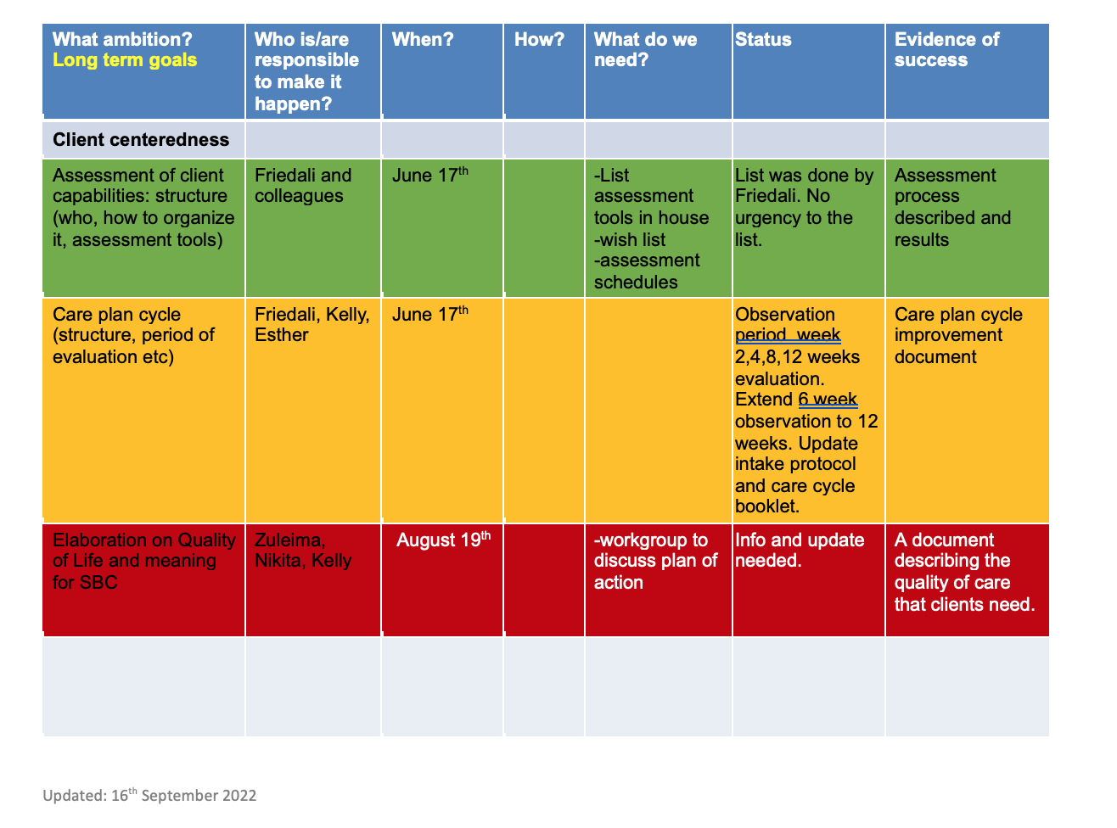

Slide 61
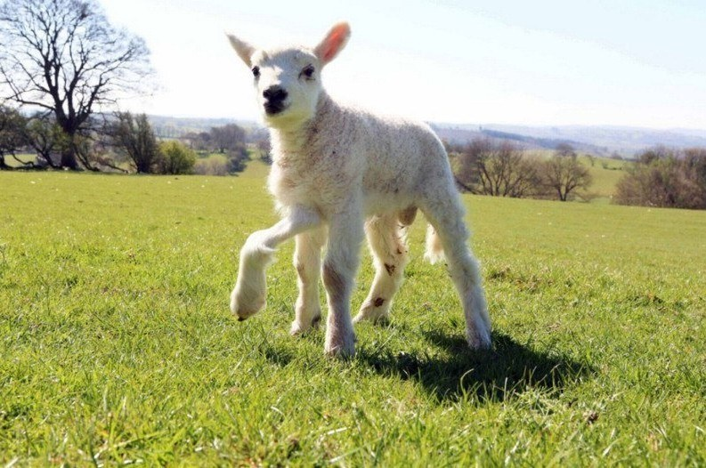
What are your roles?

Slide 62
What kind of roles?
Middle up and down
Visionary https://my.mail.ru/mail/alla2255/video/9472/9494.html
Feedback
Directive
Monitor
Coach
Motivator

Slide 63
van Kemenade
Audit Coaching Training
5. Situational leadership
Everard van Kemenade
HEd Quality Expert and
Leadership Trainer

Slide 64
Four leadership styles

Slide 65
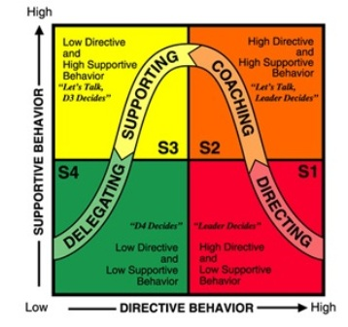
Situational Leadership
Principle: instruction and support tune with characteristics employee and job

Slide 66
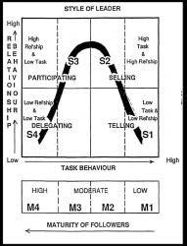
Situational leadership
Notes:
What kind of skills does this require from management?
Diagnosing maturity of followers?
Flexibility in style of leadership.

Slide 67
Situational leadership questionnaire

Slide 68
The Best Style?
The most appropriate style depends on many factors:
What is your goal?
Whom do you work with?
What are the circumstances?
What are your strengths and weaknesses?
What is your position?

Slide 69
Strengthts and Pitfalls
Style | Strenghts | Pitfalls
Power, Telling, Autocratic, Directive | Rest | Lack of cooperation, learning and recognition
Management by objectives, Selling, coach | Goal oriented | Lack of flexibility, air of favouritism
Delegating | Room for diversity and perspectives | Lack of vigor and action
Participative, Democratic | Vision, Change | Lack of control

Slide 70
Your cases

Slide 71
Summary
4Wh
Fishbone
Intervision
Vision (leader)
Vision and Action
Strategic planning cascade
Planned Action: PDCA
Many roles

