Slide 1

Workshop - Removing the roadblocks on the way to Integrated Care: a perspective workshop on reflexivity.
A Personalised Integrated Care Approach
10 mei 2021
Everard van Kemenade
Marlou de Kuiper
Mirella Minkman

Slide 2
Aim
To explore the use of the four quality paradigms in Integrated Care and shed light on the paradigmatic commitment of the reflective paradigm.
Based on a systematic review of the articles of the last 5 years of the International Journal of Integrated care for their fit in the four quality management paradigms (2020, 2021).

Slide 3
The four quality paradigms
TQM: epistemic fluency
Reflective:
Think.
Empirical:
Measure.
Un-order
Order
Emergence
Co-creation
Reference:
Model.

Slide 4
The four quality paradigms
 | Characteristics
Philosophy
Empirical | Positivism (knowledge is information derived from sensory experience and interpreted through reason and logic)
Reference | Constructivism/ Interpretivism (knowledge is made of facts that are socially constructed)
Reflective | Reflectivism and critical theory (knowledge has value to someone or something and therefore cannot be seen as being neutral)
Emergence | Pragmatism (knowledge is a tool for action and as such, it should be evaluated according to whether it serves our desired interests)
Aim
Empirical | Explanation, prediction and control
Reference | Understanding and reconstruction
Reflective | Critique and transformation
Emergence | Interaction and co-creation
Methods
Empirical | Use of verifiable evidence to arrive at research outcomes. Evidence is obtained through observation of scientific data collection.
Reference | Quantitative and qualitative methods are used to explore how reality is perceived
Reflective | Reflections, viewpoints, perspectives of professionals show differences in perceptions
Emergence | Realist evaluations, dialogue among all stakeholders and participatory research
Values
Empirical | Accountability and accuracy
Reference | Success and improvement
Reflective | Professionalism and wisdom
Emergence | Flexibility and willingness to change

Slide 5
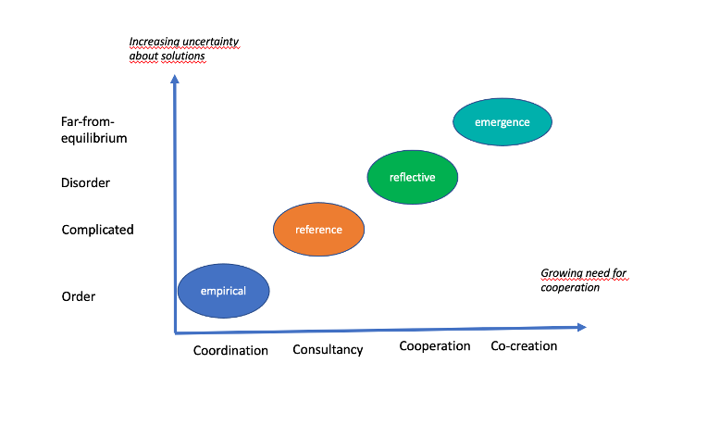
Paradigms in contexts

Slide 6
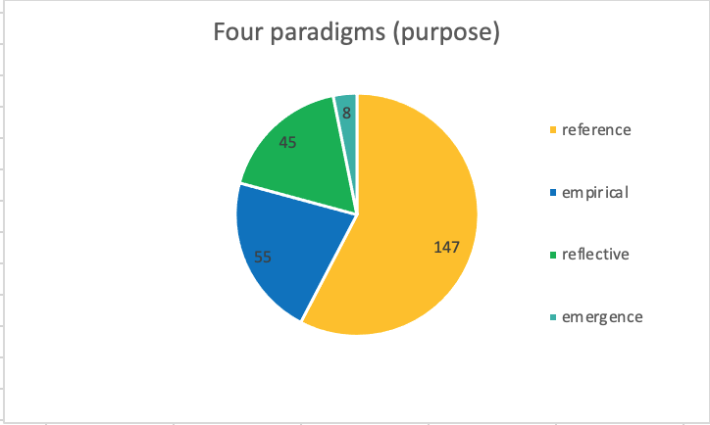
Paradigms in IJIC

Slide 7
Results
The empirical and reference paradigm are dominant, while the integrated care practice might (also) require emergence and reflexivity, since these fit best in times of disorder and far-from-equilibrium situations, in uncertainty and complexity.

Slide 8
Results
The integrated care movement needs reflective questioning of values, background assumptions and normative orientations .
West (2000) defines team reflexivity as “the extent to which group members overtly reflect on, and communicate about the group’s objectives, strategies (decision making) and processes (communication) and adapt these to current or anticipated circumstances”

Slide 9
Conclusion
The current challenge for integrated care is not about preventing the chaos to occur by planning, checking and making the right choices for adjustment. It is about perceiving, embracing the uncertainties and the chaos and seek for synergy with other organizations and people by reflexivity.

Slide 10
Reflexivity workshop (2021)
Collective reflexivity (workshop ICIC, 2021) opening and introduction (10”) presentation on collective reflexivity (15”) interaction between participants aiming at emergence of novelty based on the following questions: What are the facts that we know about effective IC development ? What models, frameworks, protocols have been developed that work? What then do we think of the current state of the art of IC development and which values exist and prevail? What emerges as a result of this dialogue and what does it mean to your situation? (45”) Conclusions (10”)

Slide 11
References
Van der Vlegel-Brouwer W, Van Kemenade E, Stein K.V., Goodwin N. & Miller R. (2020), Research in Integrated Care: The Need for More Emergent, People-Centred Approaches, International Journal of Integrated Care, 20(4): 5, 1–3. DOI: https://doi.org/10.5334/ijic.5627
Van Kemenade E, Van der Vlegel-Brouwer W, Van der Vlegel M. Exploring the Quality Paradigms in Integrated Care: The Need for Emergence and Reflection. International Journal of Integrated Care;21(2):17. DOI: http://doi.org/10.5334/ijic.5594
Van Kemenade, E.A., De Kuiper, M. & Minkman, M. (2021), Removing the roadblocks on the way to Integrated Care: a perspective paper on collective reflexivity, International Journal of Integrated Care, under review
West M. (2000), Reflexivity, revolution and innovation in work teams In: Beyerlein, M.M., Johnson, D.A. & Beyerein, S.T. (eds), Product Development teams, vol 5. Stamford, JAIpress, pp. 1-29

Slide 12
Reflexivity workshop (2021)
Collective reflexivity (workshop ICIC, 2021) opening and introduction (10”) presentation on collective reflexivity (15”) interaction between participants aiming at emergence of novelty based on the following questions: What are the facts that we know about effective IC development ? What models, frameworks, protocols have been developed that work? What then do we think of the current state of the art of IC development and which values exist and prevail? What emerges as a result of this dialogue and what does it mean to your situation? (45”) Conclusions (10”)

